Slide 1

Workshop Raspberry Pi
Created By :
Sofian Fadli, S.T.

Slide 2
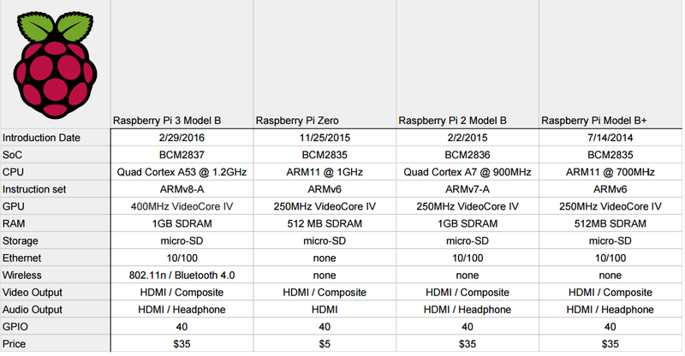
Raspberry Pi 3 Specification

Slide 3
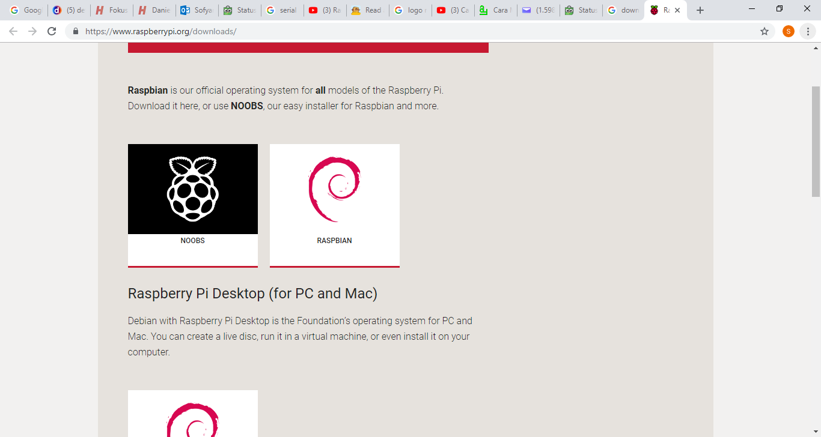
OS for Raspberry Pi (Official)

Slide 4
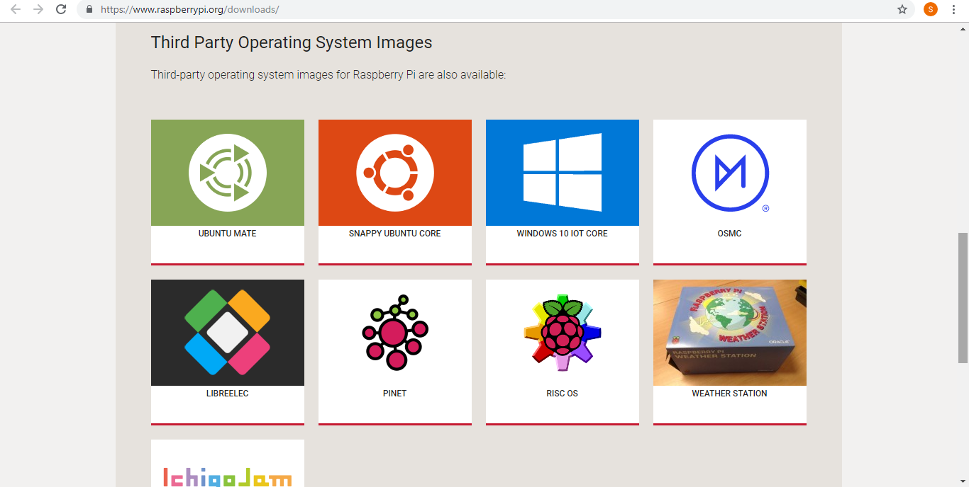
OS for Raspberry Pi (Third Party)

Slide 5
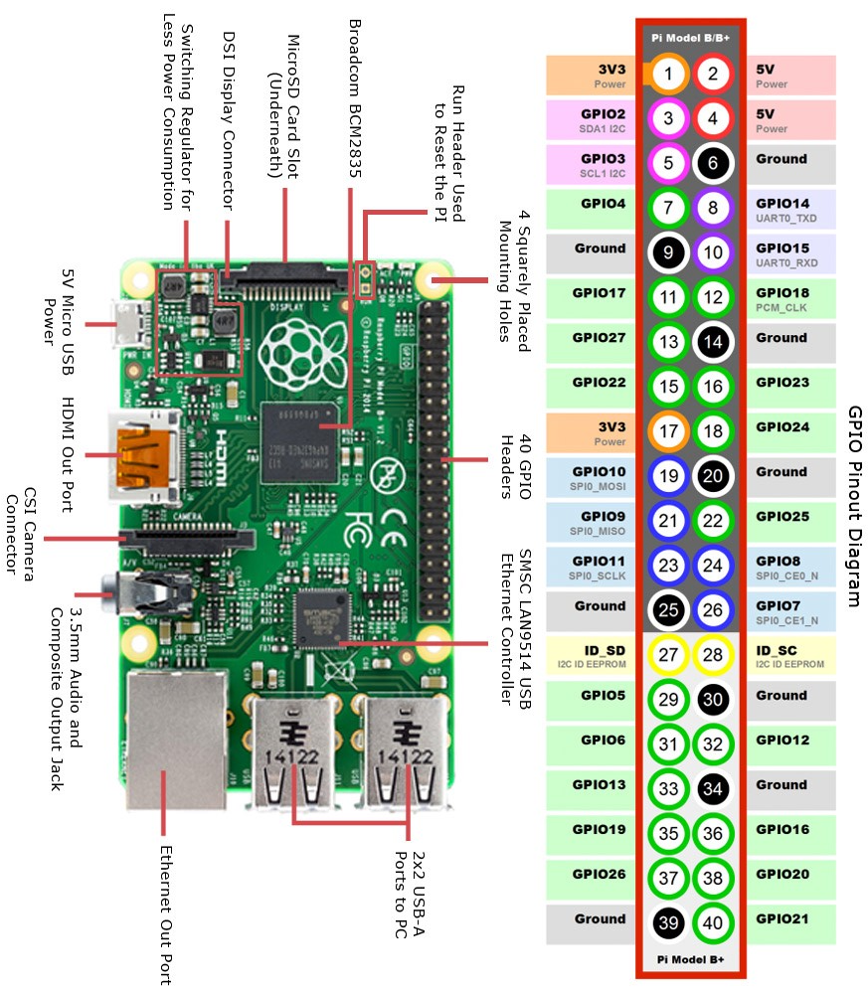
Raspberry Pi GPIO pin

Slide 6
Input / Output Raspberry Pi
Section 1

Slide 7
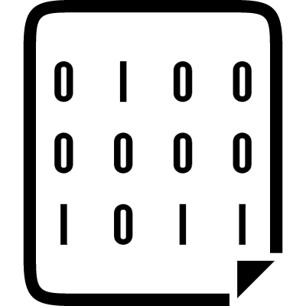

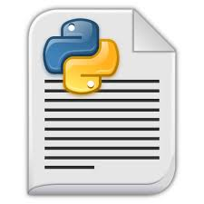
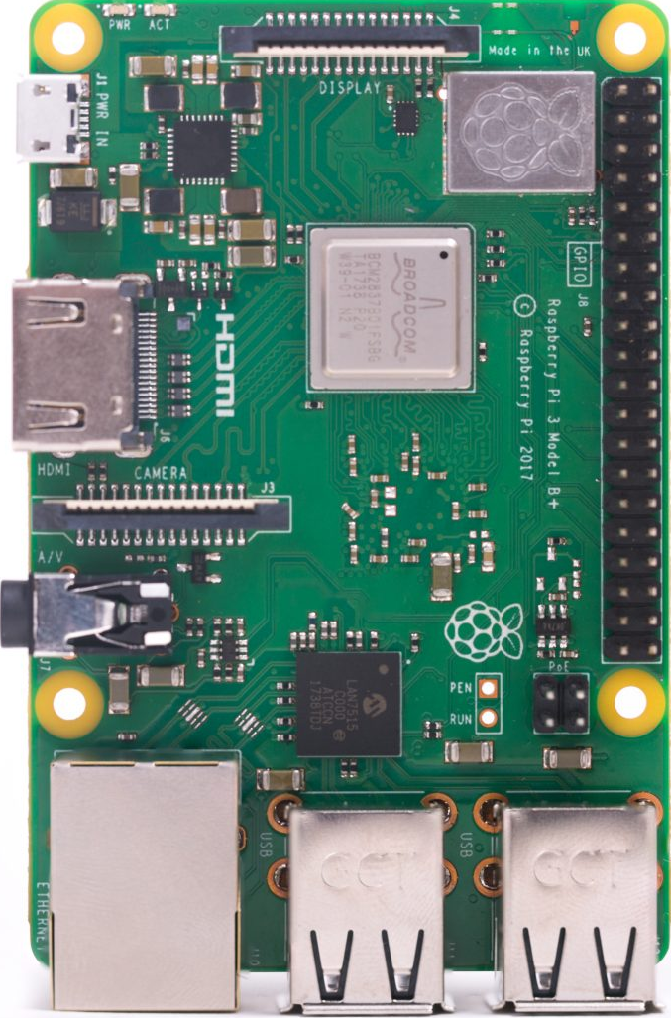
How a Program Works in Raspberry ???
Python Scripts
Python Interpreter
Machine Codes

Slide 8
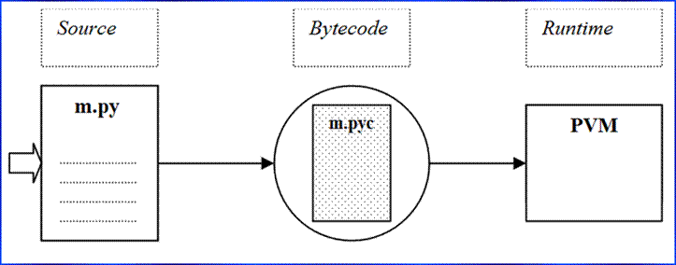
Python is Interpreted Language

Slide 9
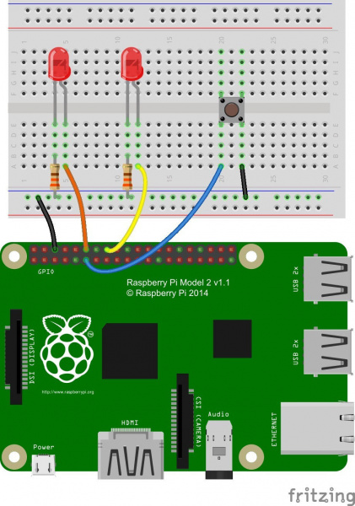
Wiring Diagram
Raspberry Pi | GPIO Board
Ground | GND
12 | 4
16 | 6
11 | 1
3V3 | VCC

Slide 10
Pulse Width Modulation (PWM)
Section 2

Slide 11
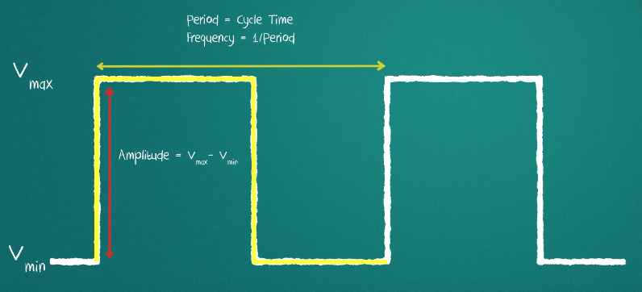
PWM’s Theory

Slide 12
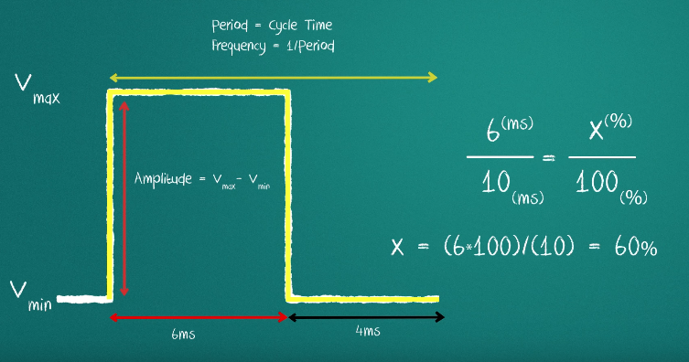
How to Calculate Duty Cycle ?

Slide 13
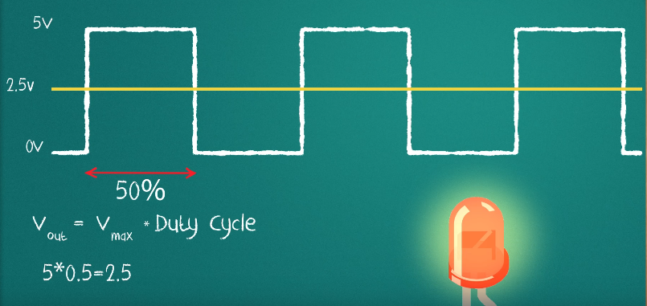
Impact Duty Cycle to Output Voltage

Slide 14
Wiring Diagram
Raspberry Pi | GPIO Board
Ground | GND
12 | 4
16 | 6
11 | 1
3V3 | VCC

Slide 15
Universal Asynchronous Receiver Transmitter (UART)
Section 3

Slide 16
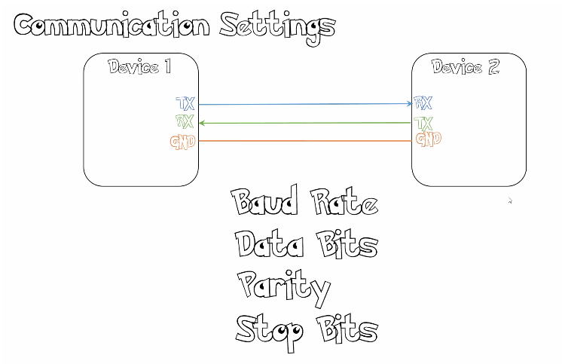
What you need to know when using UART ?

Slide 17
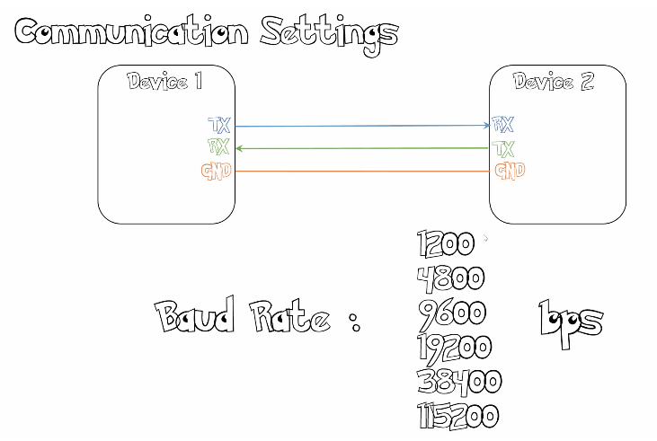
Value of standard baud rate

Slide 18
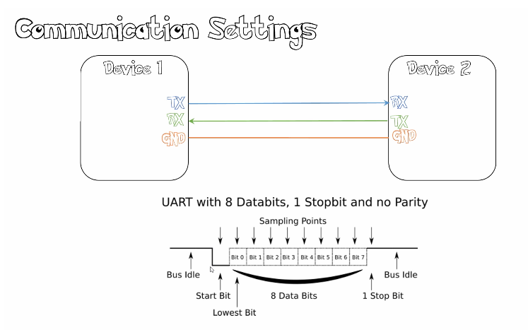
Packet Data of UART

Slide 19
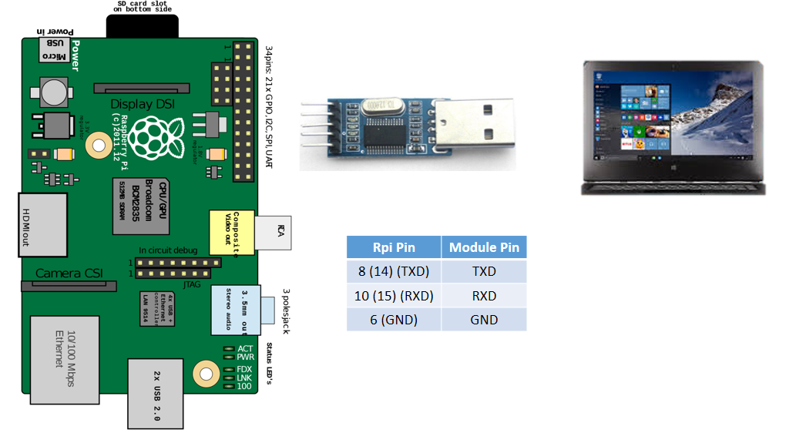
Wiring

Slide 20
I2C Communication
Section 4

Slide 21
What is I2C ???
Inter Integrated Circuit
Bidirectional Data Transfer
Half duplex (have only one data line)
Synchronous bus so data is clocked with clock signal
Clock is controlled when data line is changed

Slide 22
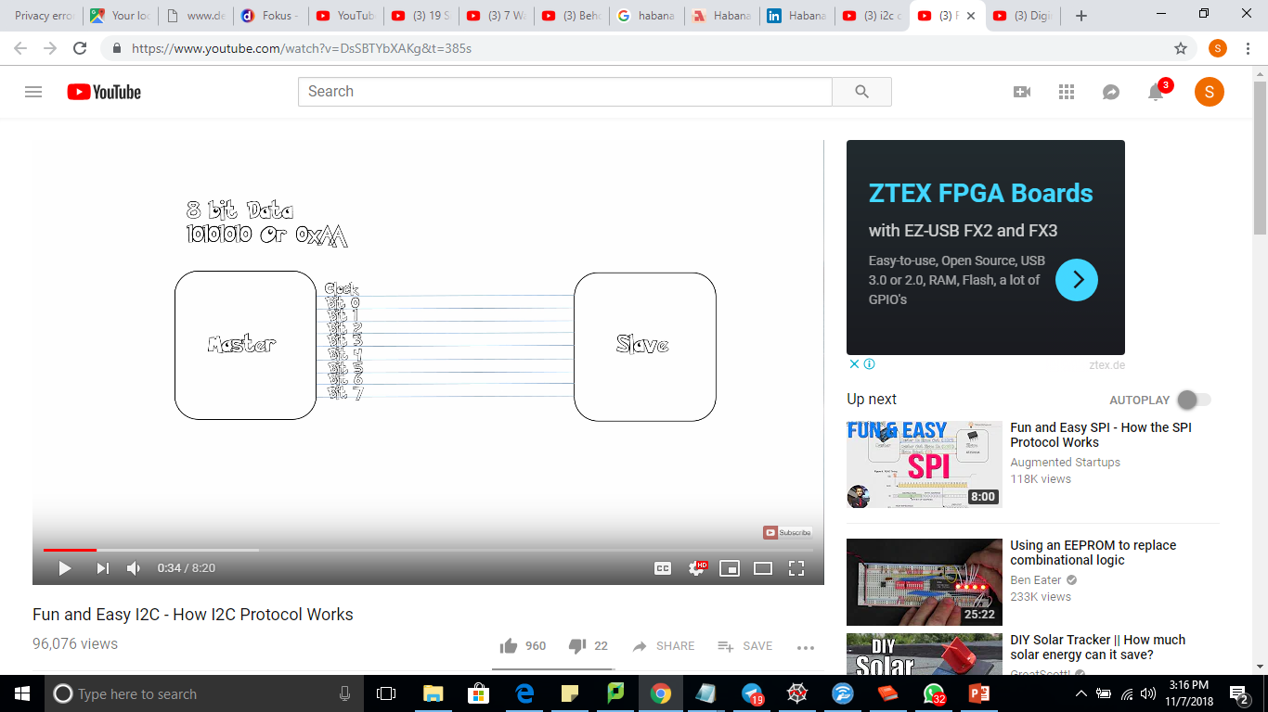
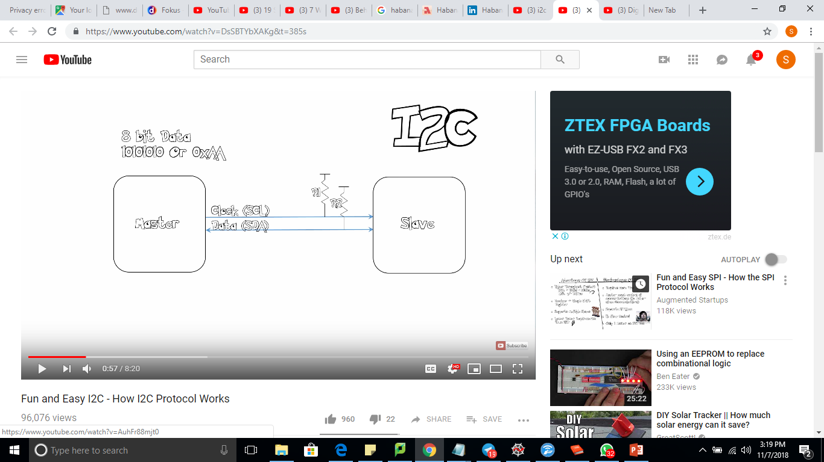
Before I2C founded
After I2C founded
Inter Integrated Circuit

Slide 23
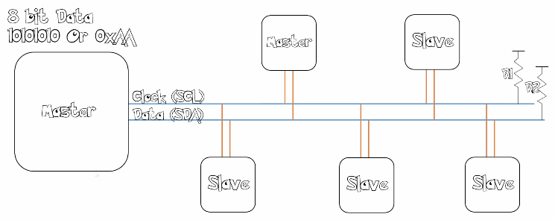
What is benefit of using I2C ???
Value of R1 and R2 control the speed of transfer data rate in I2C bus.

Slide 24
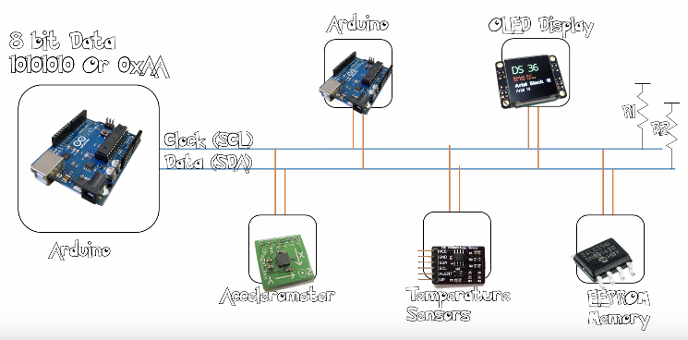
What is benefit of using I2C ???
Every devices have unique ID / address

Slide 25
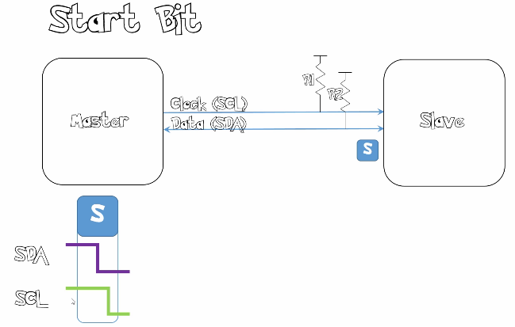
Step by Step I2C Communication
1. Master sends “start condition”

Slide 26
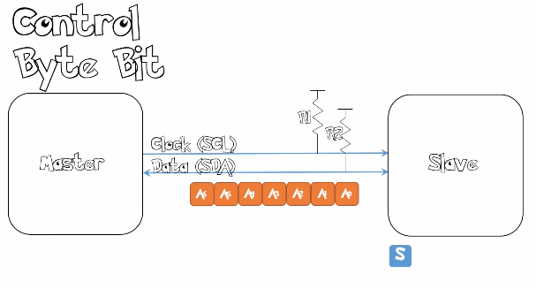
Step by Step I2C Communication
2. Master sends “Control Byte Bit” / Address Device

Slide 27
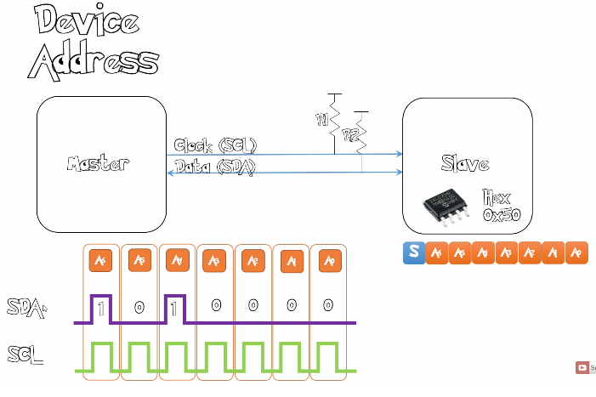

Slide 28
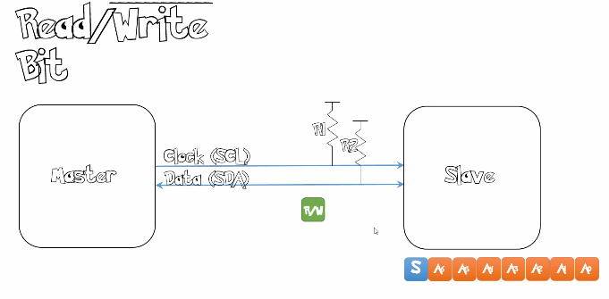
Step by Step I2C Communication
3. Master sends “Read/Write” Flag

Slide 29
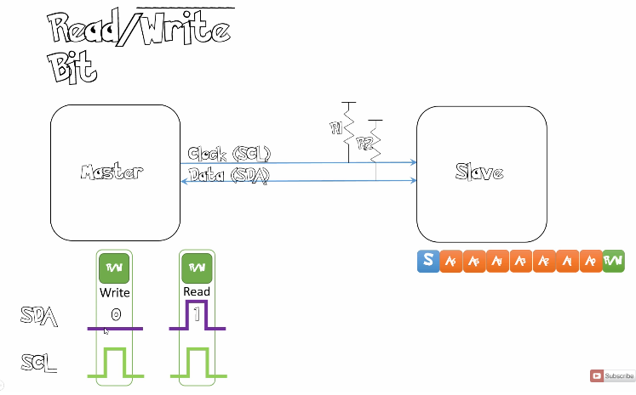
Read / Write Bit :
0 : Write
1 : Read

Slide 30
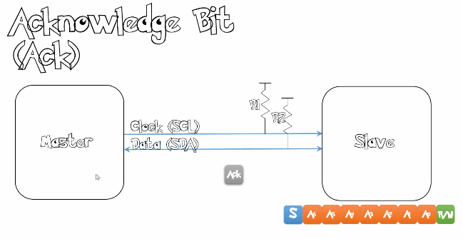
Step by Step I2C Communication
3. Slave device sends “Acknowledge Bit” signal to the Master device

Slide 31
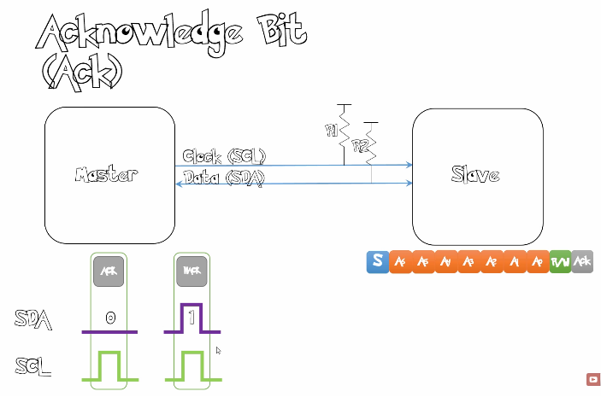
Acknowledge Bit :
0 : Acknowledge
1 : Not Acknowledge

Slide 32
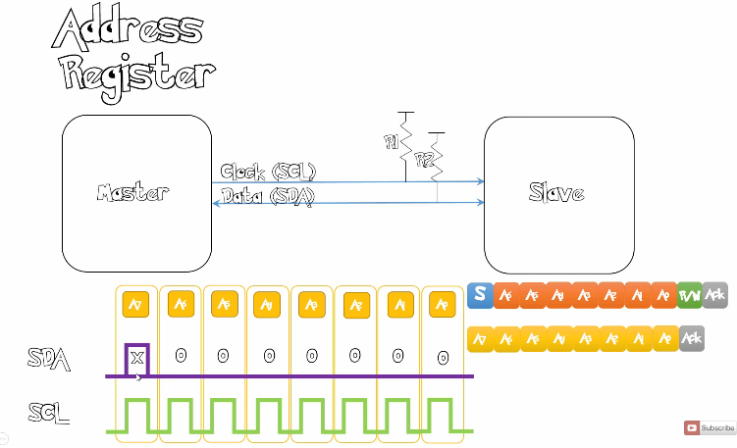
Step By Step I2C Communication
4. Master sends Address Register to the Slave

Slide 33
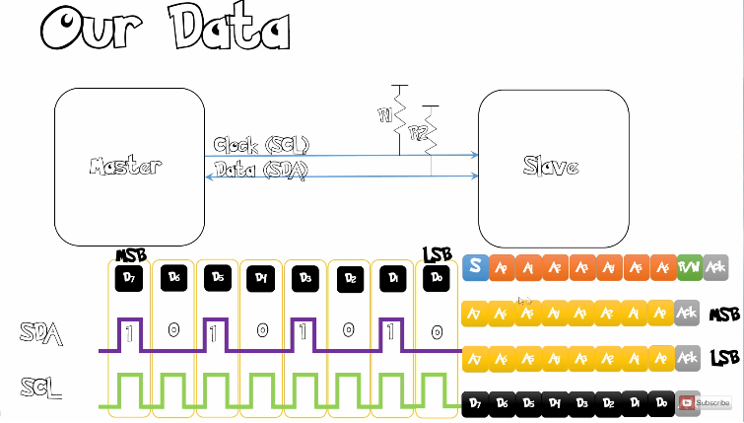
Step By Step I2C Communication
5. Slave / Master sends the data (tergantung prosesnya read / write)

Slide 34
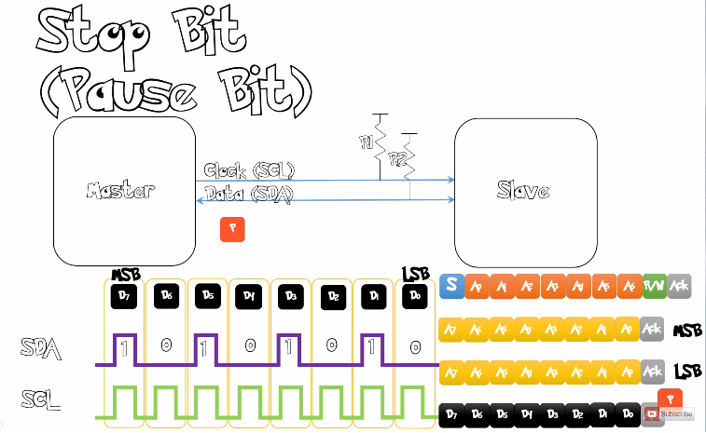
Step By Step I2C Communication
6. Master device sends “stop bit” that indicate the communication is finished.

Slide 35
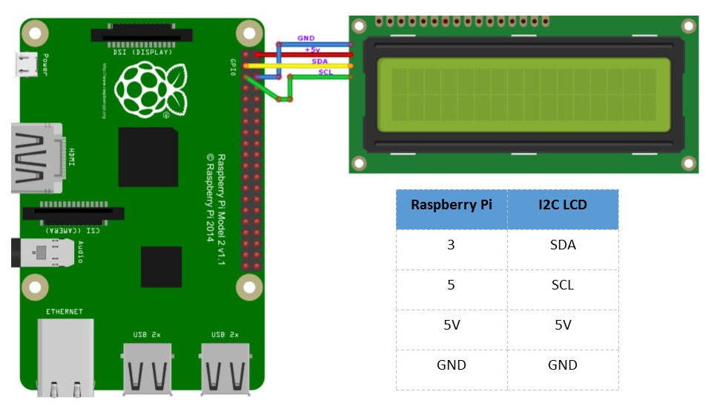
Wiring Diagram

Slide 36


Image Processing
Section 6

Slide 37
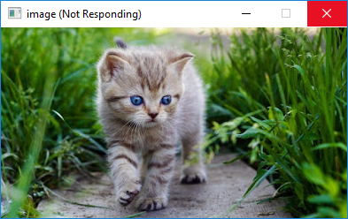
1. Menampilkan Gambar pada Window
Nama Program : visual_img.py
import cv2
img = cv2.imread('kucing.jpg')
cv2.namedWindow('image', cv2.WINDOW_AUTOSIZE)
cv2.imshow('image', img)
cv2.waitKey(10)

Slide 38
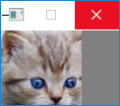
2. Mendapatkan Muka dari Kucing (ROI)
Nama Program : ROI.py
import cv2
img = cv2.imread('kucing.jpg')
# img[y1:y2, x1:x2]
head = img[29:114, 116:202]
cv2.imshow("Faces found", head)
cv2.waitKey(10)

Slide 39
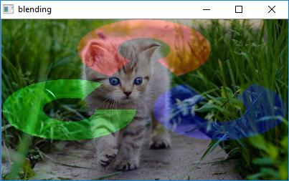
3. Menggabungkan 2 gambar sekaligus (Image Blending)
Nama Program : img_blending.py
import opencv2
img1 = cv2.imread('kucing.jpg')
img2 = cv2.imread('opencv_logo.png')
height, width = img1.shape[:2]
resized_image = cv2.resize(img2, (width, height))
dst = cv2.addWeighted(img1,0.7,resized_image,0.3,0)
cv2.imshow('blending',dst)
cv2.waitKey(10)
cv2.destroyAllWindows()

Slide 40
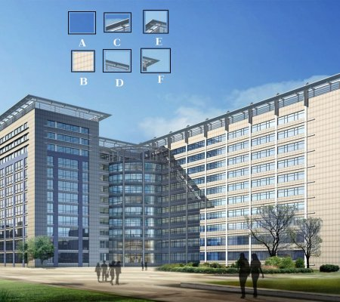
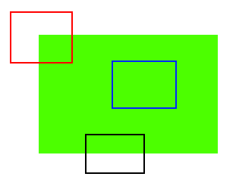
What is Features ???
E / F
A / B
C / D

Slide 41
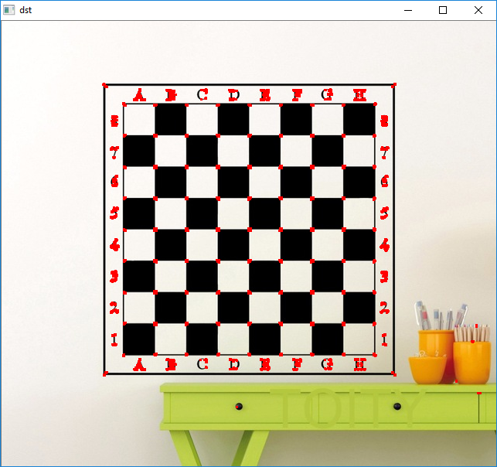
4. Harris Corner Detector
Nama Program : harris_corner.py
import cv2
import numpy as np
filename = 'chessboard.jpg'
img = cv2.imread(filename)
gray = cv2.cvtColor(img,cv2.COLOR_BGR2GRAY)
gray = np.float32(gray)
dst = cv2.cornerHarris(gray,2,3,0.04)
#result is dilated for marking the corners, not important
dst = cv2.dilate(dst,None)
# Threshold for an optimal value, it may vary depending on the image.
img[dst>0.01*dst.max()]=[0,0,255]
cv2.imshow('dst',img)
if cv2.waitKey(0) & 0xff == 27:
cv2.destroyAllWindows()

Slide 42
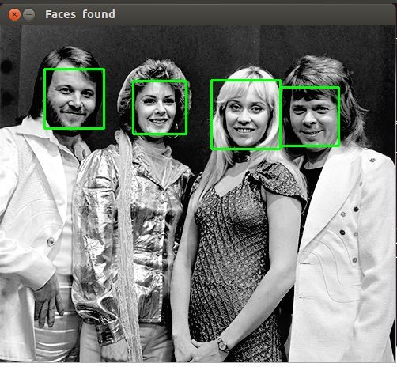
5. Face Detection (Haar Cascade Classifier)
Nama Program : face_detect_cv3.py
import cv2
import sys
# Get user supplied values
imagePath = sys.argv[1]
cascPath = "haarcascade_frontalface_default.xml"
# Create the haar cascade
faceCascade = cv2.CascadeClassifier(cascPath)
# Read the image
image = cv2.imread(imagePath)
gray = cv2.cvtColor(image, cv2.COLOR_BGR2GRAY)
# Detect faces in the image
faces = faceCascade.detectMultiScale(
gray,
scaleFactor=1.1,
minNeighbors=5,
minSize=(30, 30)
#flags = cv2.CV_HAAR_SCALE_IMAGE
)
print("Found {0} faces!".format(len(faces)))
# Draw a rectangle around the faces
for (x, y, w, h) in faces:
cv2.rectangle(image, (x, y), (x+w, y+h), (0, 255, 0), 2)
cv2.imshow("Faces found", image)
cv2.waitKey(0)

Slide 43
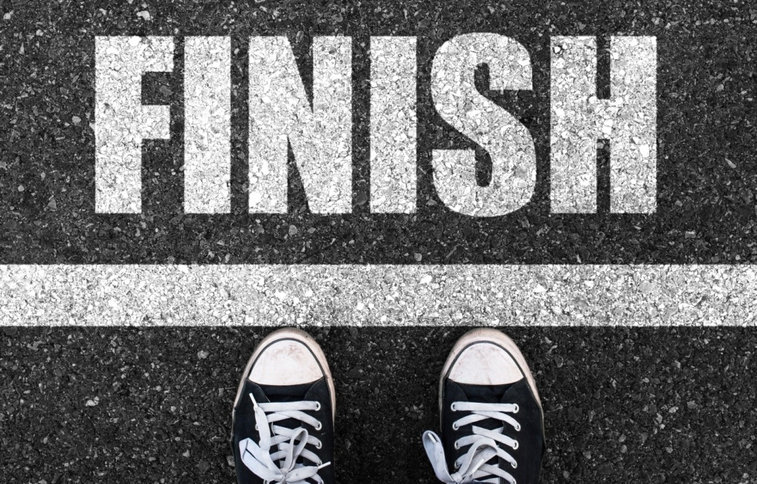

For more workshop / training, contact :
- Sofian Fadli, S.T. (HP : 087809734759 / email : nextlevel2409@gmail.com)

